Slide 1


Team Details
  Team name: [enter team name]
  Team leader name: [enter leader name]
  Problem Statement: Shoppers abandon checkout because of bugs nobody sees; teams learn about them days late, if ever.

Slide 2
Brief about the idea
Churn Preventer Agent finds the bugs that make shoppers leave, ranks them by money lost, and re-checks the past when you add a rule.
The problem
What we built
What the merchant gets
Dead buttons, wrong totals, 500 errors at checkout
Shoppers leave; they do not complain
Analytics show the drop, not the cause
One script tag records sessions, inputs masked
Code groups them: one issue per bug
Gemini explains it and checks a screenshot
Four AI jurors approve each report
Issues ranked by ₹ lost
A replay at the exact moment
Plain-English rules; a person approves
A 30-day re-scan: past victims tagged "found later"
Retail & Commerce on Google Cloud: Cloud Run, Pub/Sub, BigQuery, Firestore, Gemini on Vertex AI. All demo data is synthetic.

Slide 3
Opportunities
How is it different from existing ideas?
Replay tools flag rage clicks. We also catch silent bugs: a wrong cart total, a hidden ₹499 fee
A new rule re-scans 30 days of history; Time travel shows what we knew then vs now
How does it solve the problem?
One issue per bug across all sessions, with the ₹ lost
Gemini root cause, screenshot proof, repro steps, a replay of the moment
USP of the solution
Code decides findings and scores; Gemini explains
Four AI jurors gate each report; a person approves each rule
An eval engine tests every prompt or model change

Slide 4
List of features offered by the solution
1
One-tag SDK
rrweb recording; inputs masked, payments blocked
7
Rules in plain English
Draft, test run, approve, Undo
2
Five detectors
Rage, dead click, slow, wrong numbers, errors
8
Retroactive re-scan
30 days of raw sessions; "found later"
3
One issue per bug
Same fault across sessions = one issue
9
Churn watcher
Finds numbers that make shoppers leave
4
Revenue at risk in ₹
Cart sessions × value × abandonment gap
10
Time travel
What we knew then vs now
5
Gemini explains
Triage, root cause, screenshot check, rank
11
Replay and visual proof
Jump to the moment; screenshot confirms
6
AI jury
Four jurors and a judge; code gates at 66%
12
Agent eval engine
Golden cases test every prompt or model change

Slide 5
Process flow diagram
1
2
3
4
5
6
Shopper browses
Ingest
Detect
Group
Explain and rank
Merchant acts
One script tag records the session
Collector scrubs; Pub/Sub keeps order
Five detectors read the session
One issue per bug across sessions
Gemini, ₹ at risk, AI jury
Replay, fix, or approve a rule
How a rule learns, then finds past damage
A
B
C
D
Someone suspects
Draft and test run
A person approves
Live, then history
The churn watcher, the rule suggester or a merchant (in plain English)
Gemini drafts the rule; code compiles it and checks what it would flag
Nothing runs without a yes in the Rules tab; Undo is one click
Live within 15 s, and a re-scan of 30 days of raw sessions
Past victims return as "found later" issues and feed step 5. Every stage is idempotent: keyed by session and sequence.

Slide 6
Wireframes of the proposed solution
Churn Preventer
Dashboard Issues Rules Time travel Raw alerts
Open the shoe store
Issue page
Shoppers affected
Open issues by priority
Waiting for approval
Found later
P0 urgent · Checkout blocker
Plain title of the problem
Money lost right now
Fix these first
Revenue lost so far
Shoppers
Left
₹ total, up or down
1 issue ₹ lost % of losses
Stacked chart: money lost over time, by issue
What happened · Likely cause · Where to look first
2 issue ₹ lost % of losses
3 issue ₹ lost % of losses
How to reproduce: numbered steps with evidence chips
Issue bar + trend
Issue bar + trend
Issue bar + trend
Where shoppers hurt (by page)
Proof: screenshot with the defect outlined
Issue bar + trend
Issue bar + trend
Issue bar + trend
Reviewed by 4 AI jurors: Approved 99%
Dashboard: the first glance
Issue: why it matters, and proof

Slide 7
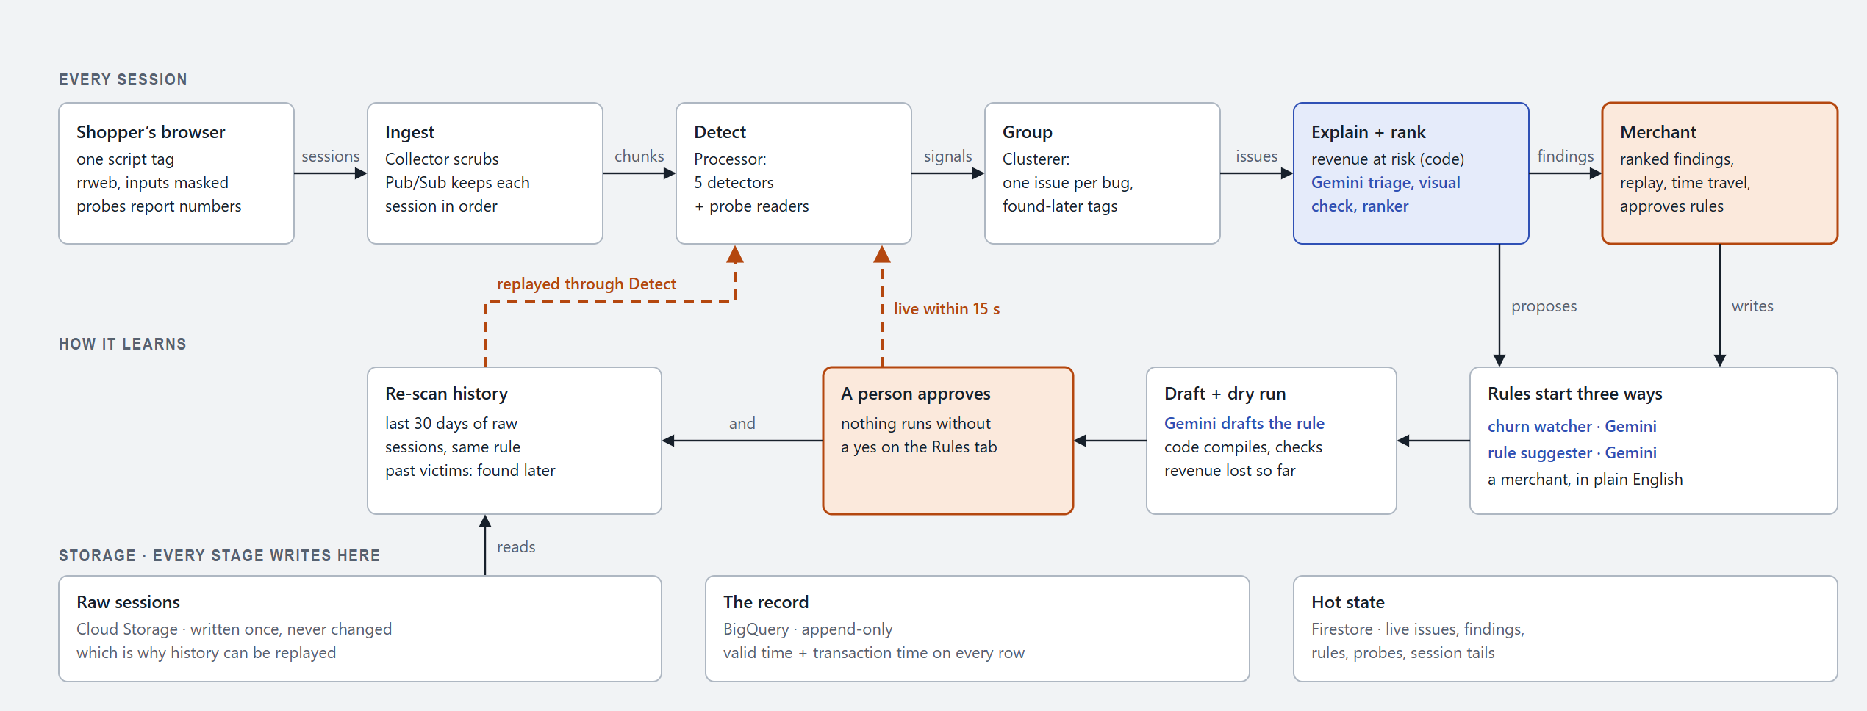
Architecture diagram of the proposed solution
Scales: volume shrinks at every tier, and only issues reach Gemini
Safe: raw sessions never change; BigQuery is append-only; Gemini sees masked evidence, never raw events

Slide 8
Technologies used in the solution
Capture SDK
Agents and LLM
Backend
rrweb 2.1.6, TypeScript
One-tag bundle (Vite)
Masking, 30 s buffer, number probes
Gemini 3.5 Flash-Lite: triage, ranker, jurors
Gemini 3.8 Flash: root cause, rules (Vertex AI)
Google ADK 2.2.1; zod-checked JSON
Node 22, TypeScript (strict)
Fastify 5: collector and API
Detectors as pure functions
Google Cloud
Dashboard and demo shop
Testing and eval
Cloud Run (6 services), Pub/Sub
Cloud Storage, BigQuery, Firestore
Secret Manager, Cloud Build
React 19, Vite, Tailwind 4, Recharts
rrweb-player for replay
Shoe store with 13 planted bugs
Vitest: 533 tests pass
Simulator with ground truth (sim:check)
Agent eval: 11 golden cases on Gemini

Slide 9
Estimated implementation cost (optional)
Cost follows issues, not sessions: only issues reach Gemini
Amounts in [brackets] are placeholders for the Cloud Billing report. Nothing here is measured
Service | What drives the cost | Monthly
Gemini on Vertex AI | 200 issues a day × (6,000 in + 1,000 out tokens) at $0.75 / $3.75 per million (Gemini 3.8 Flash, to 31 Dec 2026) | ≈ $50 (illustrative)
Cloud Run (6 services) | Agent warm (1 instance); the rest scale to zero | [₹ from billing]
Pub/Sub, Cloud Storage | Metadata messages; raw sessions expire in 30 days | [₹ from billing]
BigQuery, Firestore | Partitioned tables; live state | [₹ from billing]
Total for the demo | One tenant, synthetic traffic | [₹ total]

Slide 10
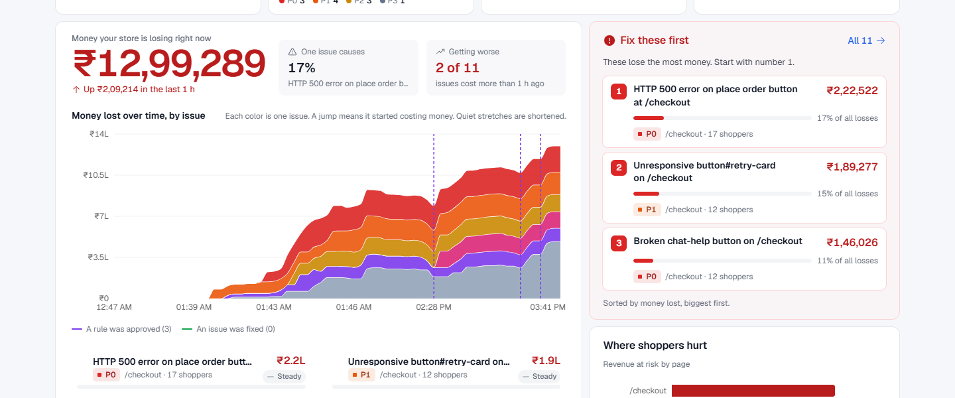
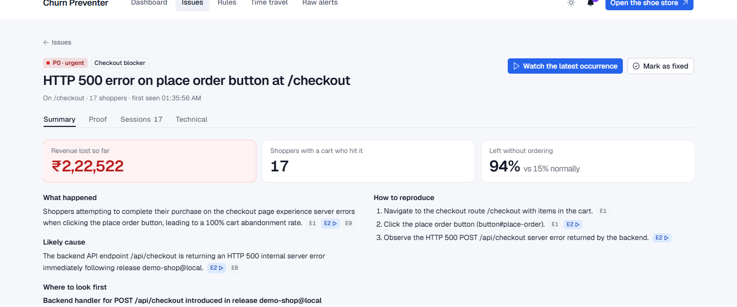
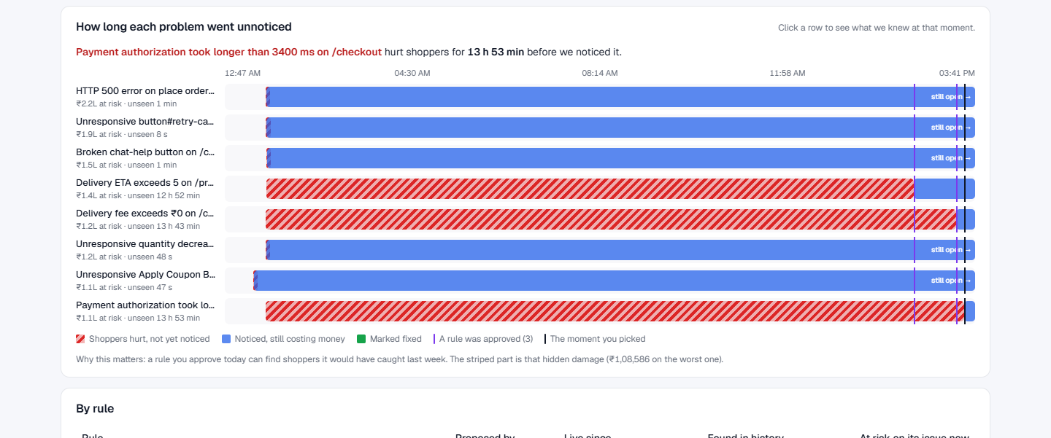
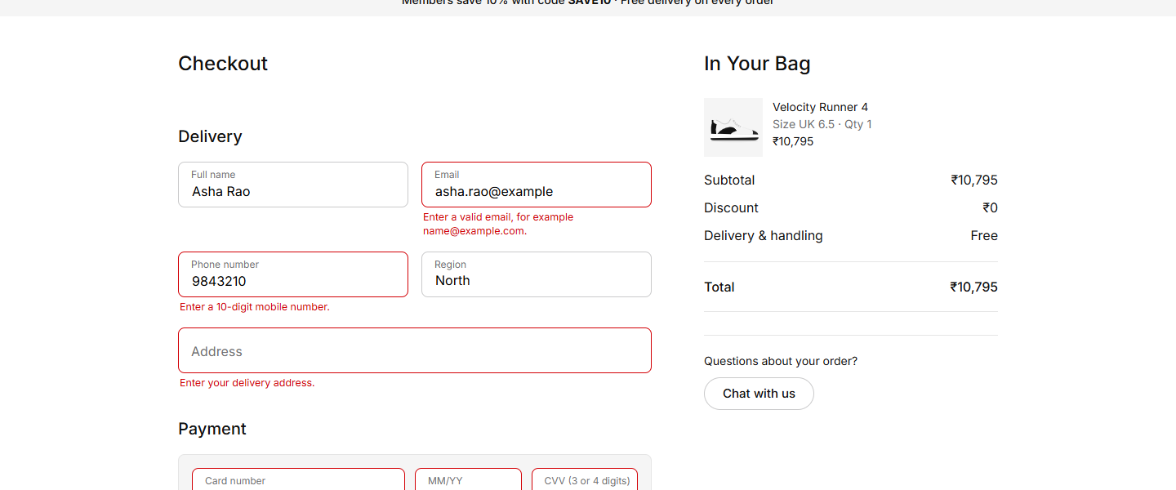
Snapshots of the prototype
Dashboard: money lost over time, by issue, and what to fix first
Issue: what happened, how to reproduce, reviewed by four AI jurors
Time travel: how long each problem went unnoticed (striped = unseen)
Demo shop checkout: each field explains what to fix

Slide 11
Prototype performance report and benchmarking
Measured on the prototype
Illustrative projection: typical mid-size footwear platform
8 of 8
0
loud bugs found, one issue each
false alarms; recall and precision 100%
27.6 s
11 of 11
shopper action to database row
golden cases pass the agent eval
240 simulated shoppers, 13 planted bugs, on Cloud Run
3 approved rules re-scanned 249 sessions in about 10 s; 12 past shoppers each
Jury approved 8 of 8 reports; 533 tests pass
Eval engine: triage, root cause, ranker and jury all pass on real Gemini
Limit: we planted the bugs, so recall is an upper bound
₹122L → ₹8.7L a month: about ₹1.13 crore kept
Illustrative projection, not a measured result. Assumed: [100,000] cart sessions a month, [₹4,000] cart, [2% / 5% / 1.5% / 4%] affected, [14 days] vs [1 day] to notice. Abandon gaps come from the simulator (normal shoppers 21%).

Slide 12
Additional details and future development
Login and signed replay links
The rebuild path for rules
The demo is public and synthetic
Real stores need sign-in and short-lived links
Rules on numbers nobody recorded
Needs a headless replay; the fast path is built
Pilot on real traffic
Alerts
Replace the projection with real abandonment gaps
Add the pilot store to the eval golden set
Slack or email when a P0 issue appears
Scale-out
Out of scope by design
Per-tenant subscriptions and quotas
Shared session cache; BigQuery Storage Write API
Heatmaps, funnels, mobile SDKs, billing
Auto-fixing customer code

Slide 13
Provide links to your:
GitHub public repository
https://github.com/anshj0712/gemai-defcon1
[make the repository public before submitting: it is private today]
Demo video link (3 minutes)
[demo video link: not recorded yet]
Final product link
https://cp-api-w46tbwzpaq-el.a.run.app
Churn dashboard (no login; synthetic data). Its "Open the shoe store" button opens the demo shop: https://cp-shop-w46tbwzpaq-el.a.run.app

Slide 15


